Slide 1

VIETNAM INTERNATIONAL UNIVERSITY – HO CHI MINH CITY
INTERNATIONAL UNIVERSITY
WEB APPLICATION DEVELOPMENT PROJECT
E-Commerce Project
Members of Group:
Lê Thành Đại Dương_ITITUN14002
Vương Khắc Duy_ITITUN14010
Ninh Thế Lâm_ ITITUN14007
GitHub Link: https://github.com/tieuduong241096/2017S2-WEB_LAB-

Slide 2
Out Line
Introduction
User Analysis
Design
User Manual
Conclusion and Future Work

Slide 3
Introduction
Information | Details
Team members | 3 members: Dương , Lâm , Duy
Business | Web Application Development Project: E-Commerce Web
Customer | International University – Viet Nam National University Ho Chi Minh City
Contact | Office: 6th floor, A Block, International University, Thu Duc, HCMC. Email: Tel:

Slide 4
Organization and Roles
Name | Role | Contact | Email Address
Le Thanh Dai Duong | Leader, Search function, Database creator, Documentation | 0972814029
Ninh The Lam | Developer, History Purchase function, Database creator, Documentation | 0967765001
Vuong Khac Duy | Developer, Recommend Items function, Feed back function, Documentation | 0902844839

Slide 5
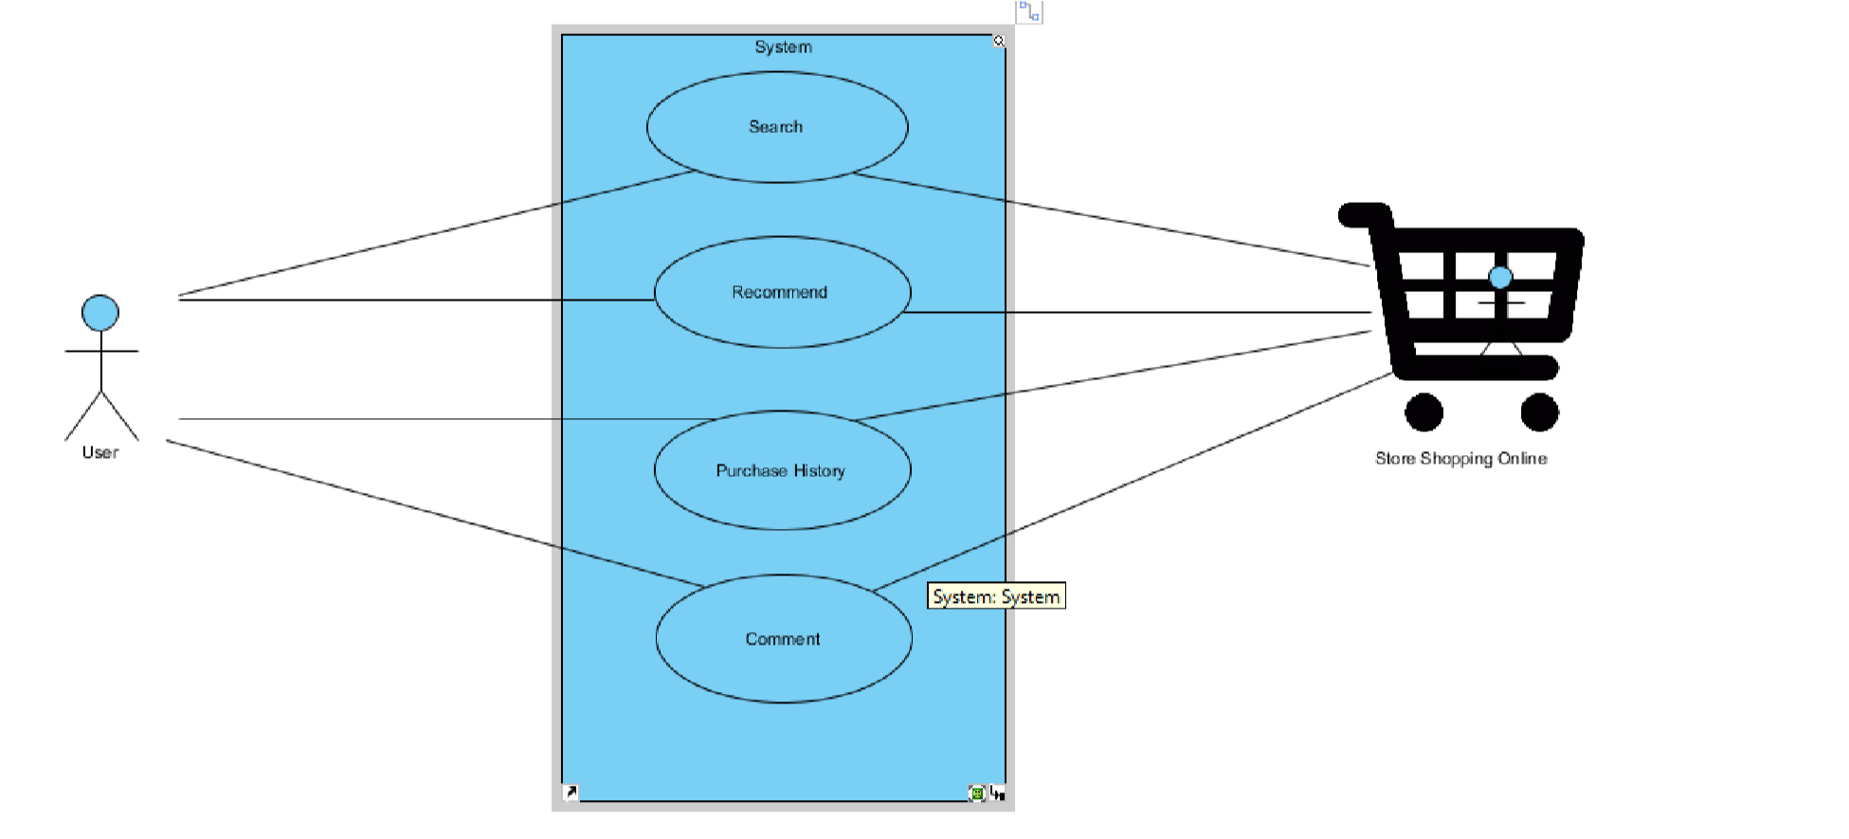
B User Analysis
Use case Diagrams

Slide 6
Purchase History
Description: Show the list of purchase information of the user
Identifier: UC2
Inputs: User ID
Output: Information of purchase history
Precondition: Users have to log in with their own account.
Post condition: None.
User story: Customers can check the purchase history in the future.
ACTOR(User) | SYSTEM
1. Login | Display login page
2. Input User Name and Password
3. Submit | Check username and password If true, show the purchase history Else return to Login

Slide 7
Feedback
Description: Show list feedback of customers on each item.
Identifier: UC4
Inputs: none
Output : The list of comment of customers on each item.
Precondition: None
Post condition: None
User story: The list of recommend products.
ACTOR(User) | SYSTEM
1.Access to home page | • Show the list of recommend products.
2 Click on each item | • Show list feedback on each items

Slide 8
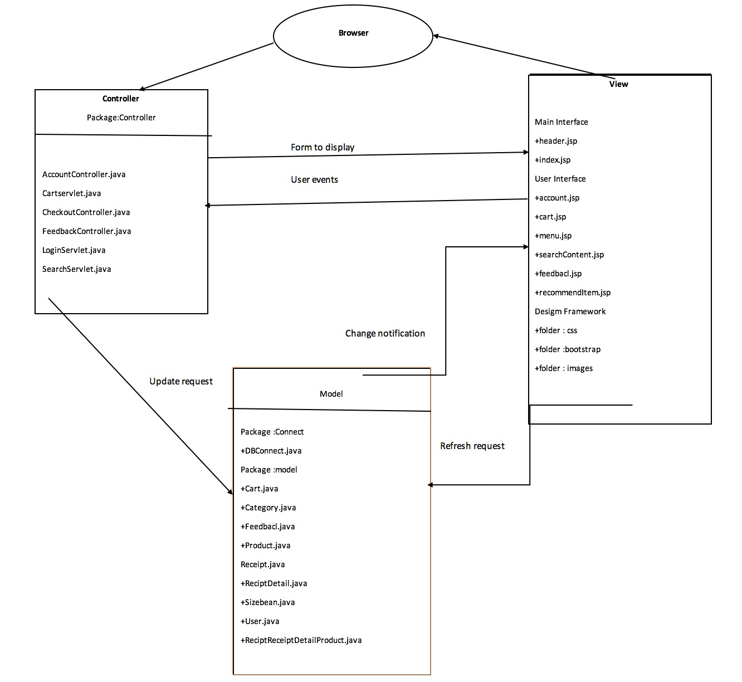
Model- View-Controller pattern

Slide 9
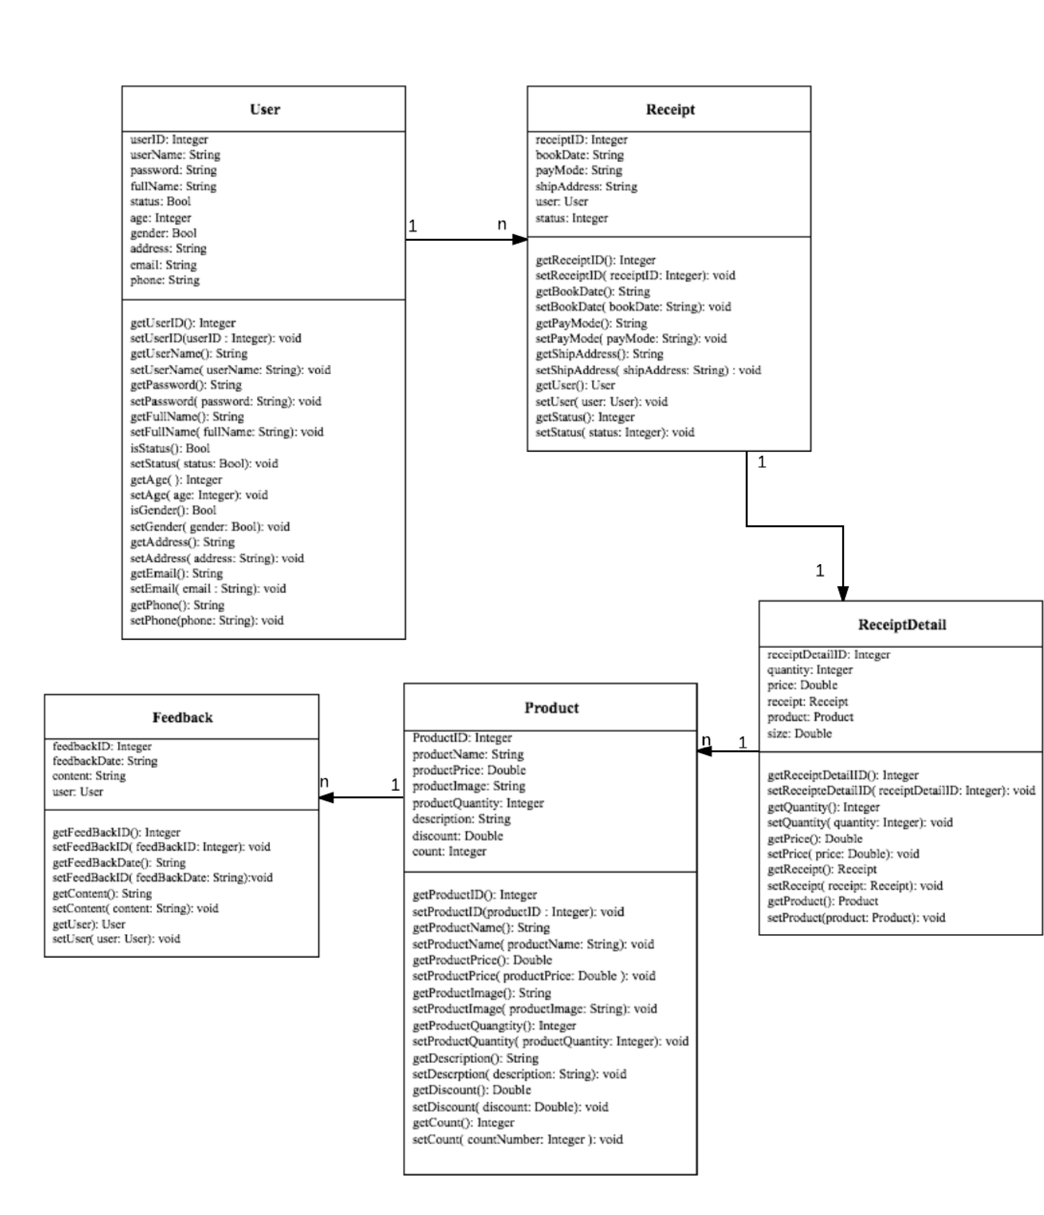
Class Diagram

Slide 10
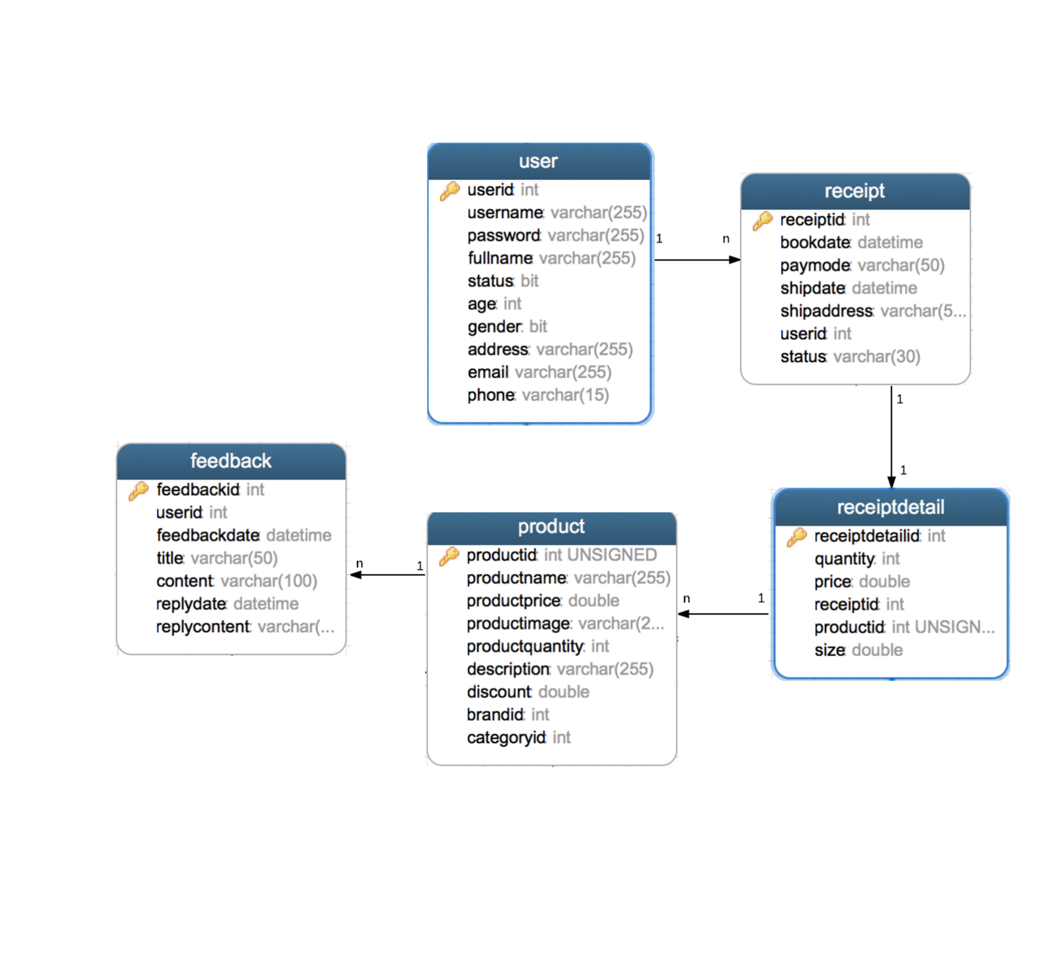
Database Design

Slide 11
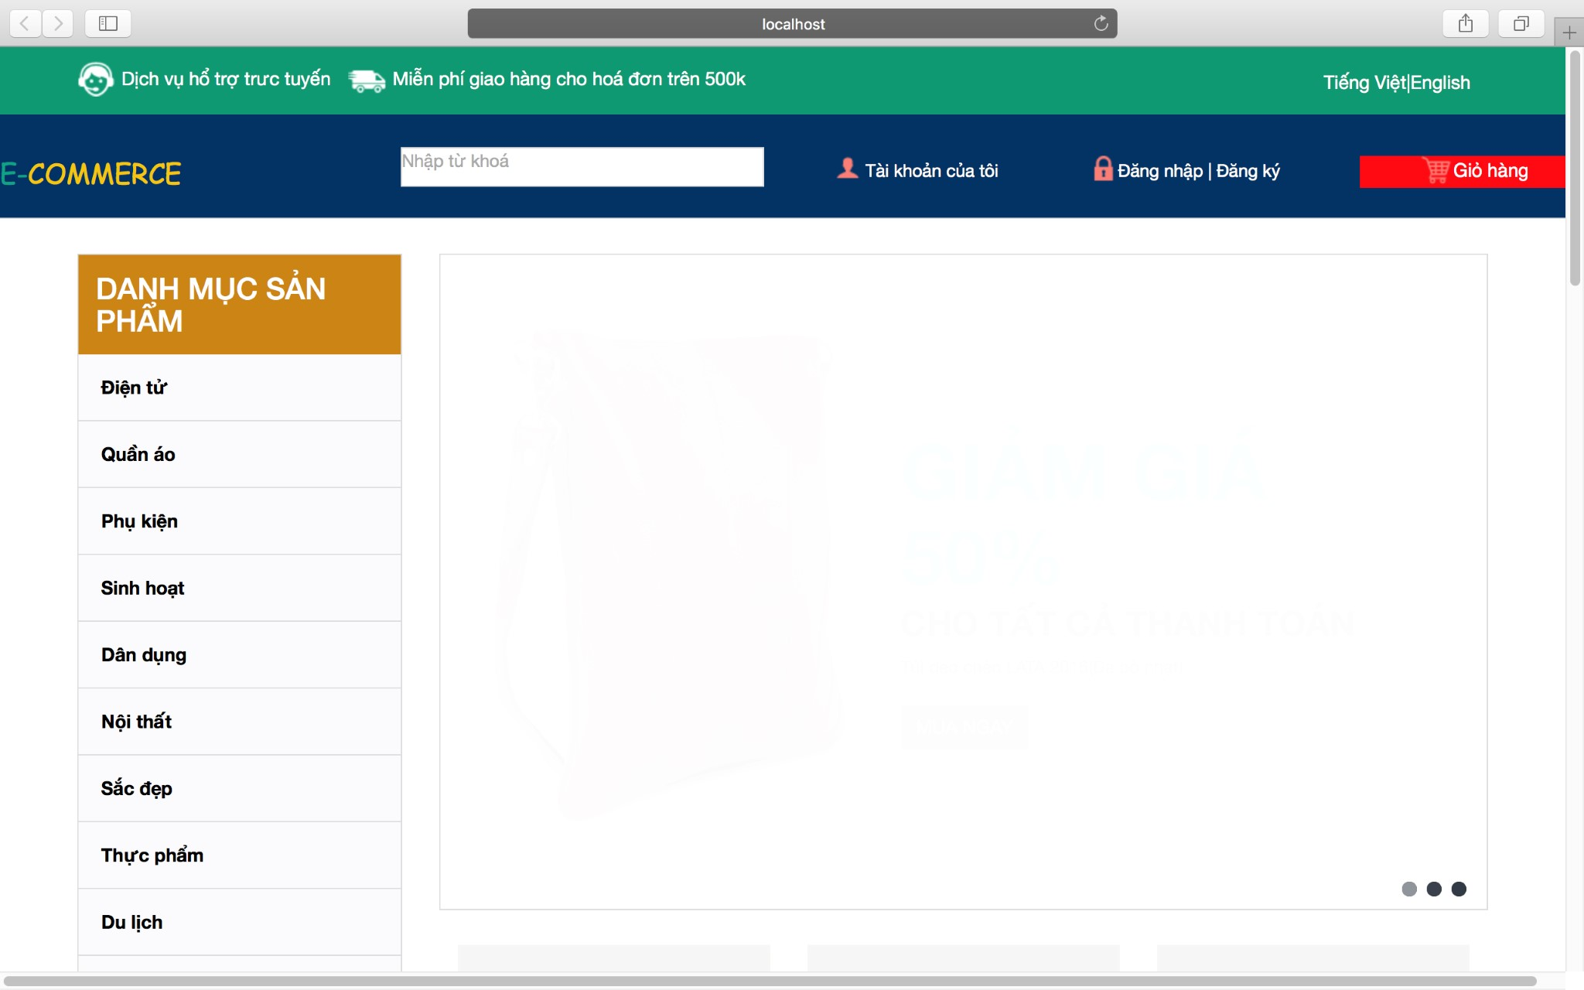
D User Manual
Main Page

Slide 12
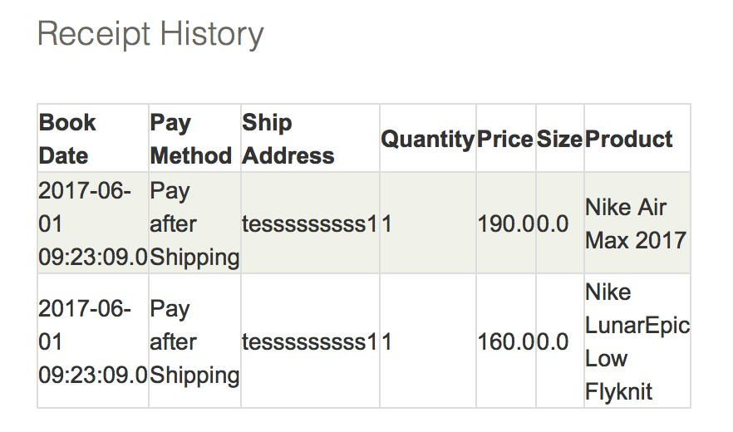
History Purchase

Slide 13
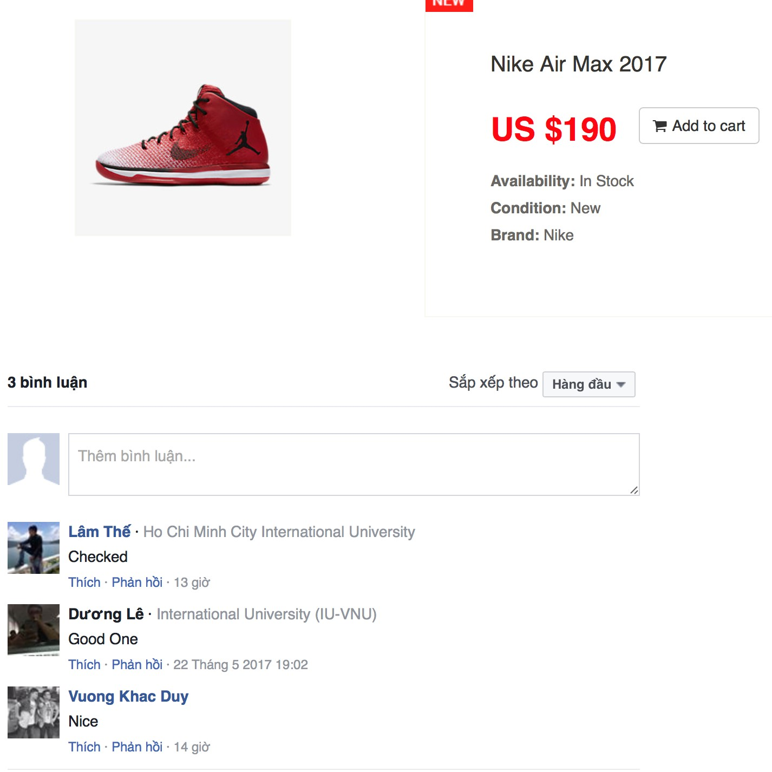
FeedBack Items

Slide 14
E Conclusion and Future Work
Final Thoughts : + The project need more time to development overly of we want to deploy it to the public.
+ Needs vary massively and very hard to handle every possibility.
Future Works:
+ Fixing every mistakes made in the demo version.
+ Optimizing the GUI , recoganize the system’s file-management and mapping, naming relation.

Slide 15

Demonstration

Slide 16


